Slide 1

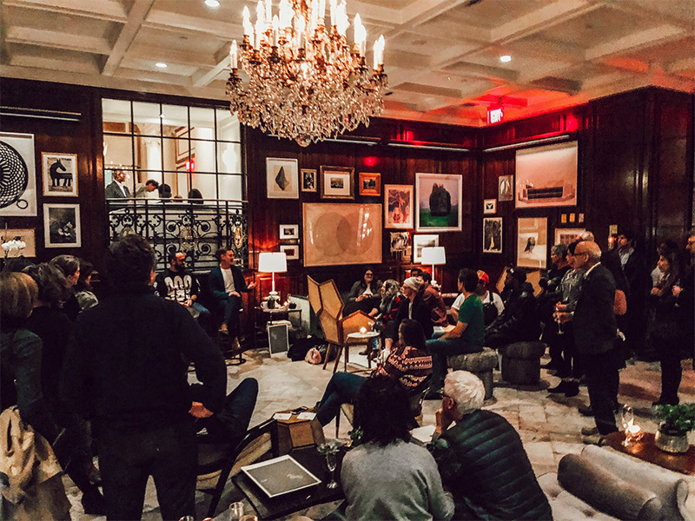

Salon Lola
SL

Slide 2
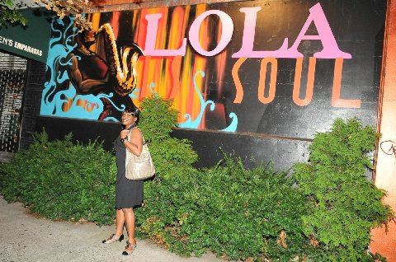

Executive Summary
OBJECTIVE: To create a better society through social change, empowerment and transformation via a creative hybrid of cultural center and restaurant, catering to lovers of music, great food, entertainment and those who share in our passionate desire to elevate themselves and others. The first location will be in Harlem with an intention to partner, scale and grow in local and international markets
MISSION: To be a purpose driven, experiential organization using this vibrant, artistic social environment to attract, engage, delight and retain a diverse array of customers and partners through our offerings and membership program. We hold the belief that civic participation, political-equality and cultural determination continue to be vital to the continuing growth of our communities and humanity. We will create opportunity to combine and share these ideas in one beautiful space for living, loving, eating, drinking and connecting.
KEYS TO SUCCESS: Creating a transformative experience through engagement. Leveraging Lola Gayle’s previous experience as a Human Resources Business Partner with requisite change management skills for a large global organization, and success as co-owner of the Lola brand. Success will be achieved by using her experience to hit critical checkpoints in education and development and social and entertainment networks.

Slide 3
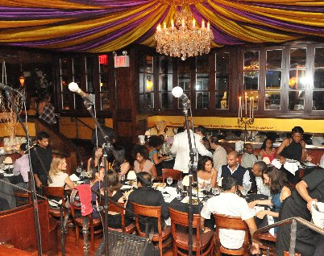
Salon Lola is a for-profit cultural center, with multiple stages and a lease space for a restaurant. It will be located in Harlem and beautifully designed for emotional impact with education, entertainment, and great food, as its centerpiece.
At the Salon Lola everyone is striving for everything worth having. The entire space will be used for marketing our agenda by blending creative artistry and thought-provoking installation art in critical places throughout the establishment, together with a soundtrack that uplifts the soul. We will craft invitations for participation via Investment, Partnership, Sponsorship and Grants of like-minded Think Tanks, Celebrity Artists, Producers, Writers, Progressive Politicians, PBS, Arts Education and others focused on a shared value proposition within leadership and enlightenment initiatives. Our focus is the inclusion of a diverse brilliant crowd with the passion and spending power to support the mission.

Slide 4

Offering Summary
Salon Lola is seeking to raise $5M, to design and build a facility.
Return of principal
Return on investment
Reporting: P&L statements generated monthly
Projected R.O.I
The For-profit, Salon Lola, has been structured as an LLC in the city of New York.

Slide 5

A UNIQUE CULTURAL EXPERIENCE WHERE ARTS, EDUCATION, COMMUNITY, FOOD AND POLITICS CONSCIOUSLY COLLIDE
A buzzing cultural and activity center for the entire family, the Salon Lola will set the table for a multidisciplinary approach to engagement and empowerment through entertainment and education. Consciously combining thought leadership with artistic expression, cultivating variety shows, music competitions, cultural arts, an exciting cuisine, a social media platform aimed at global connections and a support structure for members, leadership development for entrepreneurs and support for small business owners, mentorship, artistic competition, with programming for children and young adults to mention a few. Ultimately, we will purposefully act as an agent for CHANGE, the integration and transformation of humanity by creating opportunities for communities to converge and engage in conversation and exchange of ideas, always consistently working as a collective to impact positive change in our world.

Slide 6
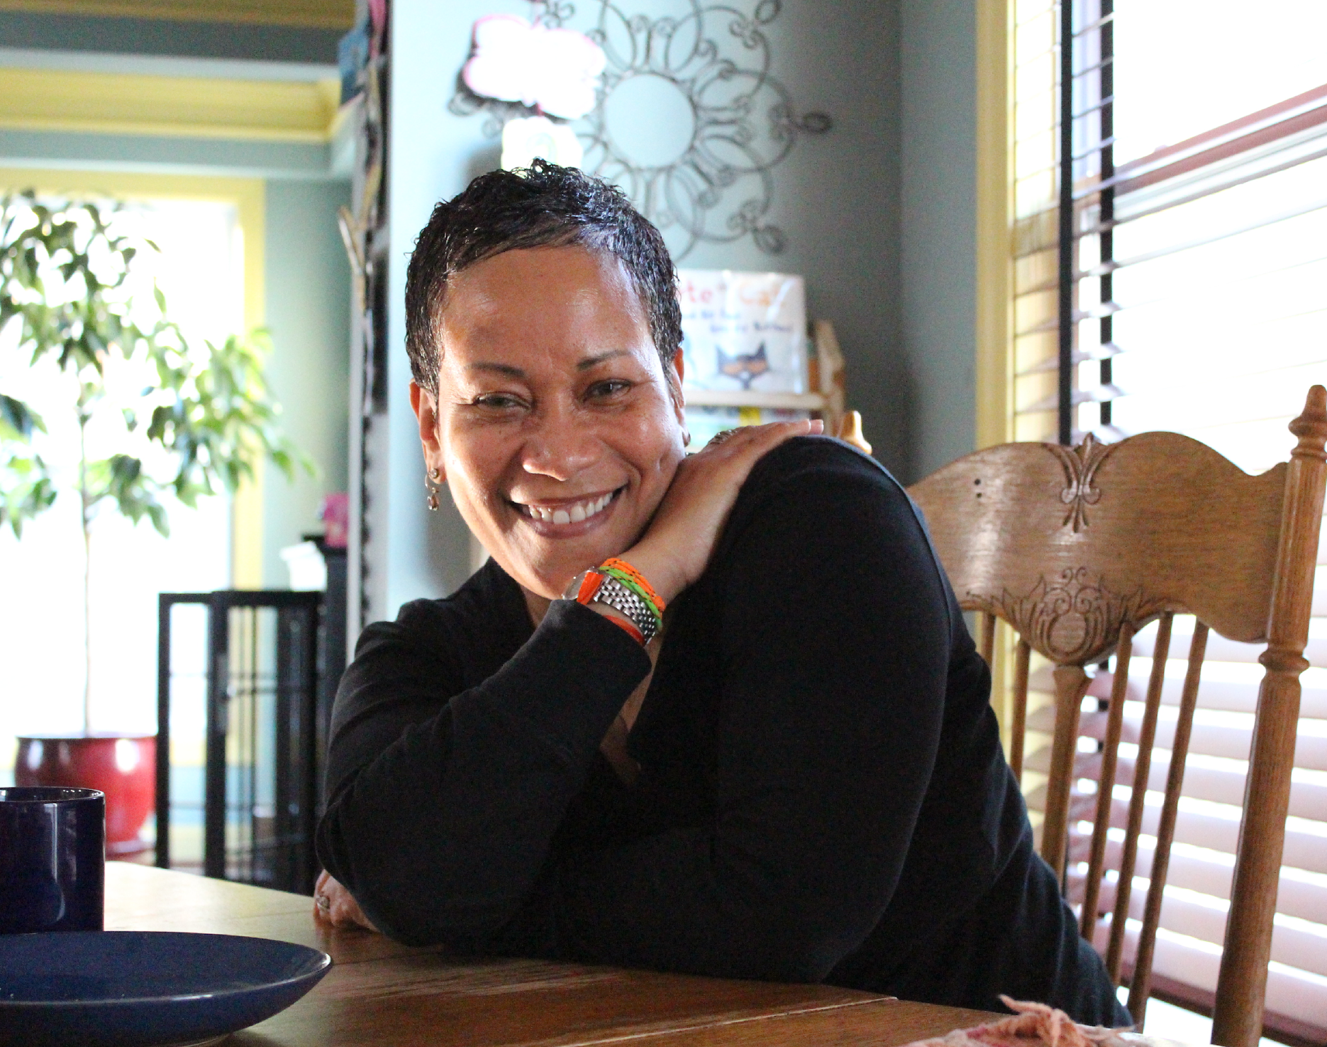
About Lola
Lola-Gayle is an unapologetic idealist, a native of Barbados with postgraduate degrees from New York University and Smith College. She is a business consultant and the co-owner of Lola Restaurant with her husband. Prior to operating Lola Restaurant full-time, she was a Vice President and Senior Human Resources Business Partner for JPMorgan Chase with direct responsibility for over 1,000 employees globally, managing budgets of over $50M. Among her many accomplishments Lola was listed as: One of the “Women Changing the World” by Essence Magazine. She travelled to Ethiopia and Tanzania as a US Delegate and guest of the Sullivan Foundation and has been a keynote speaker for NYC Universities and organizations. Lola was recently recognized by Bronx Connect with the icons and innovators for social justice award, she is an extremely charming personality and seasoned professional.

Slide 7

Opportunity In Harlem
State and Local Resources
Competition
OPPORTUNITY
COMPETITION PRIORITIZATION
Evolving Market
Ted Talks YouTube TikToc
92nd Street Y & Jazz at Lincoln Center
Prioritization
63% African American
9.5% White
22.2% Hispanic
Bringing together a diverse, changing community
Julia De Burgos Latino Cultural Center
Harlem Cultural Archives
Over 180,000 Residents
Caribbean Cultural Center Diaspora Institute
Highlighting Events for people of color
Culture
FOOD
Classes
MUSIC

Slide 8
Membership Model
Membership will be offered at two levels (Gold and Platinum)
Gold
Gold Membership is $100 per month or $1200 annually
10% discount on meals
Access to events
Free and discounted tickets to partner events
Access to partner Career and Life Coaches with a 10% discount on all coaching services
Monthly Newsletter
Concierge Parking
Platinum
Platinum Membership is $150 monthly or $1800 annually
10% discount on meals and first round of cocktails on the house
Early access to events and preferred seating
Free and discounted tickets to partner events.
Access to partner Career and Life Coaches at a 10% discount, with first two coaching sessions free of charge.
Concierge Services TBD
Monthly Newsletter
Concierge Parking
Invitation to Chef Table twice monthly

Slide 9




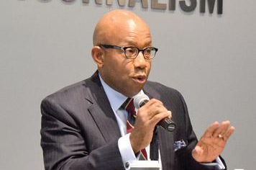



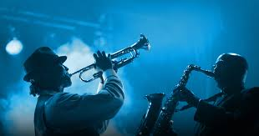
Product Summary
The business of the Salon will continue by enabling and spotlighting the Artistic community thru hosting introductory receptions monthly for promising Artists. Twelve visual Artists specifically painters, photographers and fashion designers will compete to participate within education and schools for the arts. A partnership between the Artist and the business will be created whereby the Artists benefit from exposure to grow their confidence, sales from within the space and the company website which will also serve as an E-Commerce site, offering more exposure and possible commitments from sponsors and partners to further enable their livelihood.
On a quarterly basis we will host music competitions focused on unearthing and enabling new talent with prize money, ongoing work and possible music contracts from relationships with leaders within the music industry.
We will develop programming to introduce Thought Leaders in a creative fashion by marrying their work with a variety of Artists to produce exciting and engaging stage shows aimed at excavating authenticity, stressing the importance and power of integrity in enabling our personal progress and transforming humanity.
Poetry slam competitions, and creatively placing music in the mix with other artistic expression will keep the stage vibrant and compelling.
The music played in the space will also be carefully selected to enhance mood and time of day, yet most importantly will always reflect on mission.

Slide 10

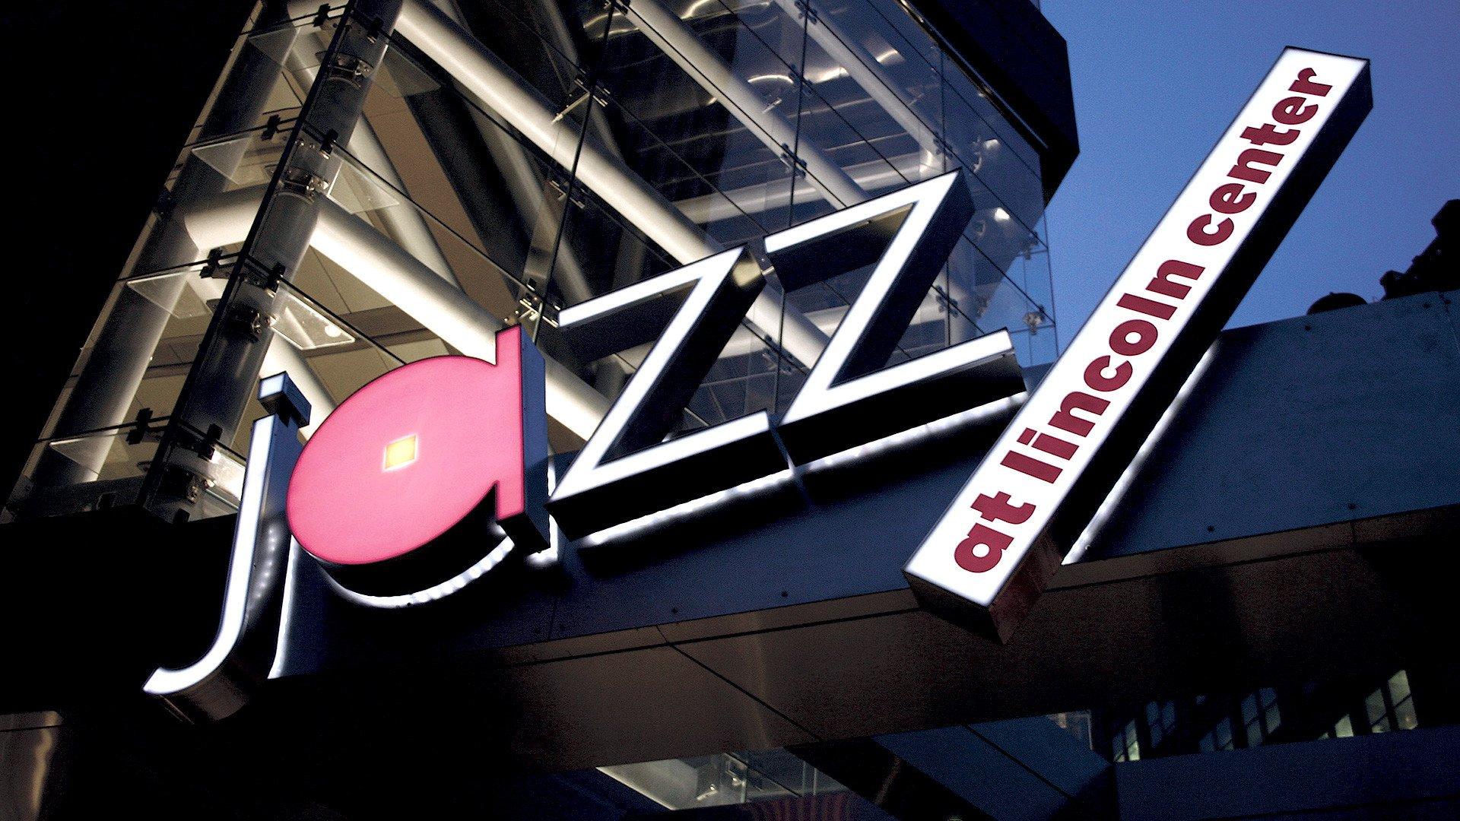
Competitor Matrix
Founded 145 years ago to serve the Jewish people, 92nd Street Y promotes individual and family development and participation in civic life within the context of Jewish values and American pluralism. As a nonprofit community and cultural center, 92nd Street Y seeks to create, provide and disseminate programs of distinction that foster the physical and mental health of human beings throughout their lives, their educational and spiritual growth and their enjoyment
92nd Street Y reaches out beyond its core constituency of American Jews to serve people of diverse racial, religious, ethnic and economic backgrounds, seeking partnerships that leaven our programs and broaden our influence.
A buzzing cultural and activity center, the Salon Lola will set the table for a multidisciplinary approach to engagement and empowerment through education by consciously combining memorable music, the arts, food and community, as well as through several other programming initiatives, such as cooking classes, leadership development for entrepreneurs and small business owners, mentorship, culture sharing and community relations to mention a few. Ultimately, we will purposefully act as an agent for the integration and transformation of humanity while creating opportunities for communities to converge and engage in conversation and exchange of ideas, working as a collective to impact positive change in our world.
In the Spirit of Swing. The mission of Jazz at Lincoln Center is to entertain, enrich and expand a global community for jazz through performance, education and advocacy. Founded 1987.

Slide 11
Market Analysis Summary
The eminent urbanist Richard Florida notes, “dystopian predictions” of the death of cities from the pandemic “are but the latest in a long-line of such prognostications.” When the pandemic ends, he predicts “we will look back and see that the roster of the world’s leading cities is unchanged.”
Market Summary
Competition in this market is usually tough, when it comes to cultural centers and stage entertainment. The Covid-19 Pandemic will change the New York City landscape significantly, as many venues have closed, with more to come.
With that as a given, Salon Lola still provides a very specific, much needed product for an underserved market segment, particularly in the 125th Street/Columbia University area of Harlem.
In 2019 The Dept of Homeland Security classified white supremacy as the greatest domestic terror threat facing the USA. Lola’s determination to focus on baking love into every aspect of business is paramount in healing a divide.
Market Segmentation
There are several markets at play, and each will be targeted as part of the overall strategy.
Since there are other entities and influential individuals, on mission to create better societies, we will craft invitations for the participation at varying levels (Investment, Partnership, Sponsorship and Grants) of like-minded Think Tanks, Celebrity Artists, Educational Organizations, Producers, Writers, Progressive Politicians and PBS.
Our focus is the inclusion of a diverse crowd with the passion and spending power to support the mission.
On a quarterly basis we will host music competitions focused on unearthing and enabling new talent with prize money, ongoing work and possible music contracts from relationships with leaders within the music industry.
The Lola Partnership will use its previous, successful experience to shape the market and involve thought leaders.

Slide 12




Social Media
Technology will play a critical role in driving and advancing the mission and objectives via a social media forum aimed at building a larger global community. Salon Lola will push for transformational outcomes and most of the daily marketing will be through social media. Through site administrators, the online community will link up for additional value in the physical spaces to fortify the agenda, boost sales and grow stronger communities.
TOP SOCIAL MEDIA SITES
FACEBOOK
YOUTUBE
1.59
1.44
Billion users each month
Billion users each month
INSTAGRAM
TWITTER
TICTOK
850
Million active users
400
320
Milion active monthly users
Milion active monthly users

Slide 13
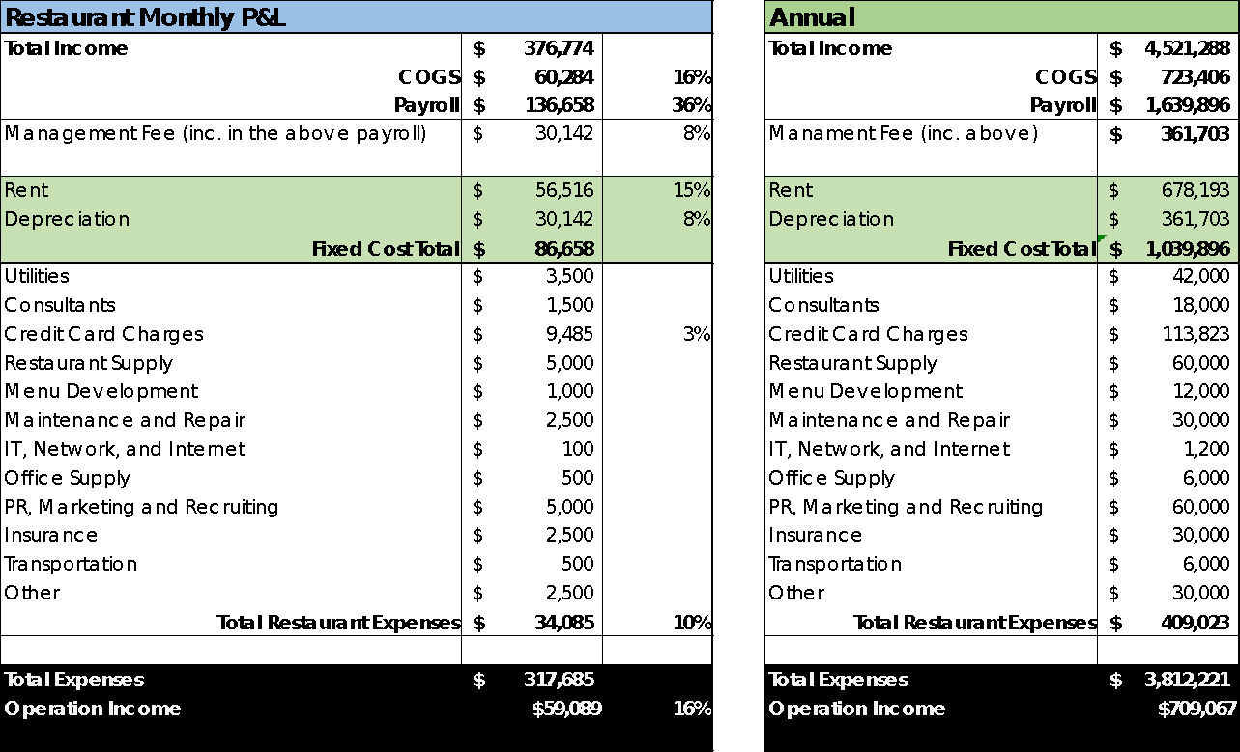
Financials

Slide 14
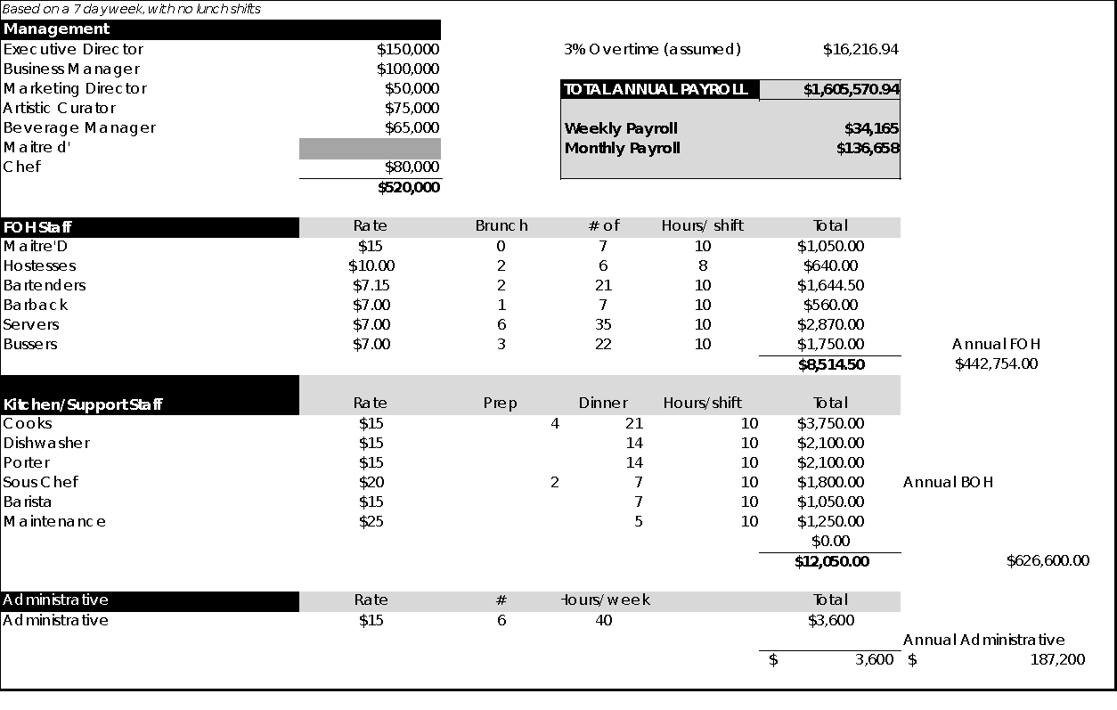
Payroll

Slide 15
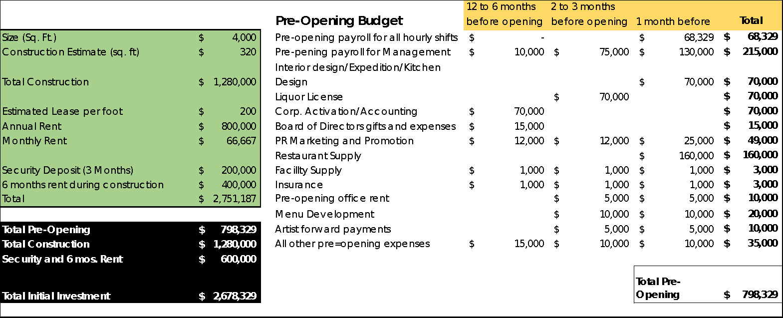
Initial Investment Summary

